Slide 1
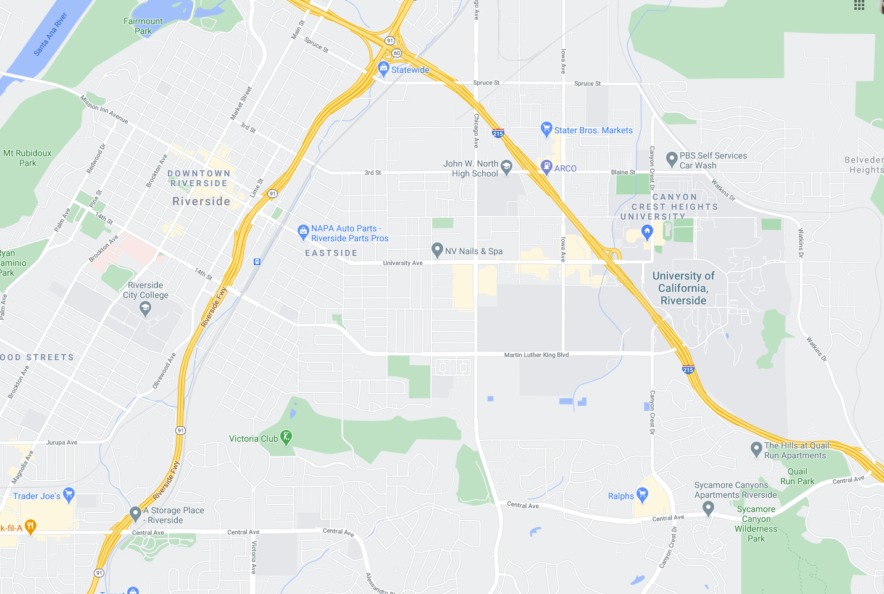
FEW2
FWE1
HEW5
HWE1
HEW4
FWE2
HEW3
HEW2
HEW1
FEW1
HWE2
HWE3
HWE4
HWE5

